Slide 1
Autonomous Vehicle Simulator
Adam Goldstein

Slide 2
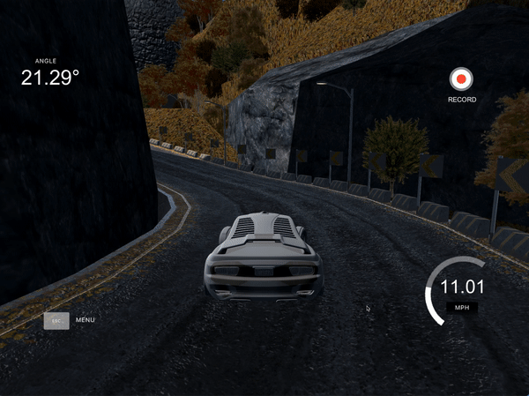
Data Collection
Training data was collected by driving 5 laps around the track
Images were taken from 3 camera angles (left, right, center)
Simultaneously, steering angle was collected at 14 data points per second.

Slide 3
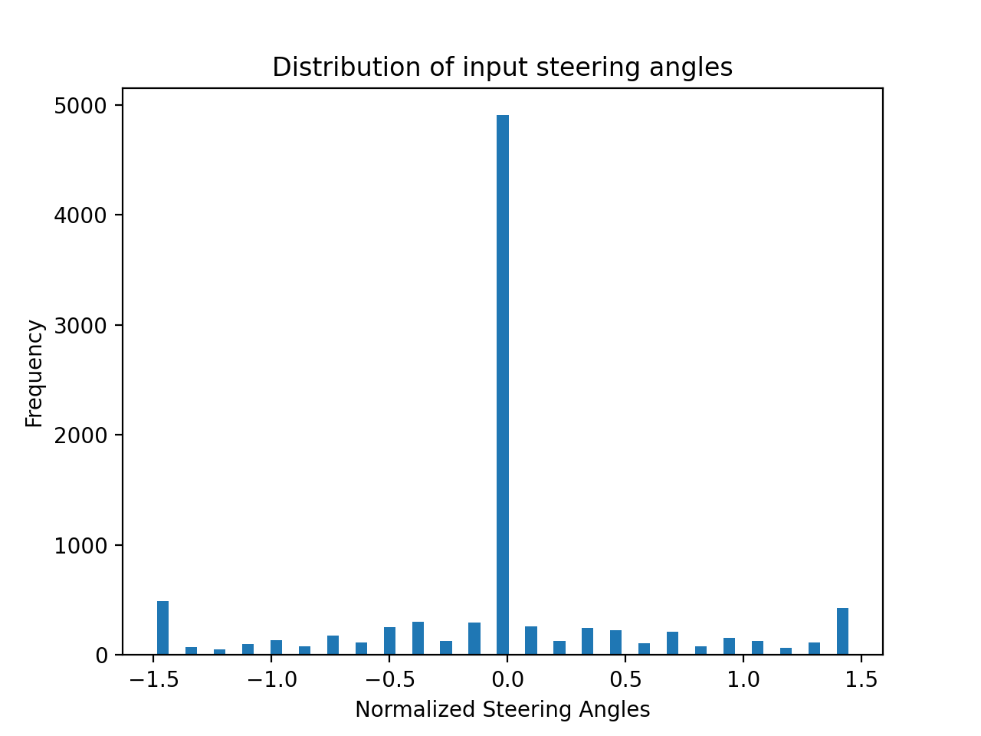
EDA
Steering angles from training data show highest frequency at angle 0
This is because car is almost entirely moving straight
Additionally, steering shows significant frequency at -1.5, 1.5
If I used a joystick instead of a keyboard, data would likely transition more smoothly

Slide 4
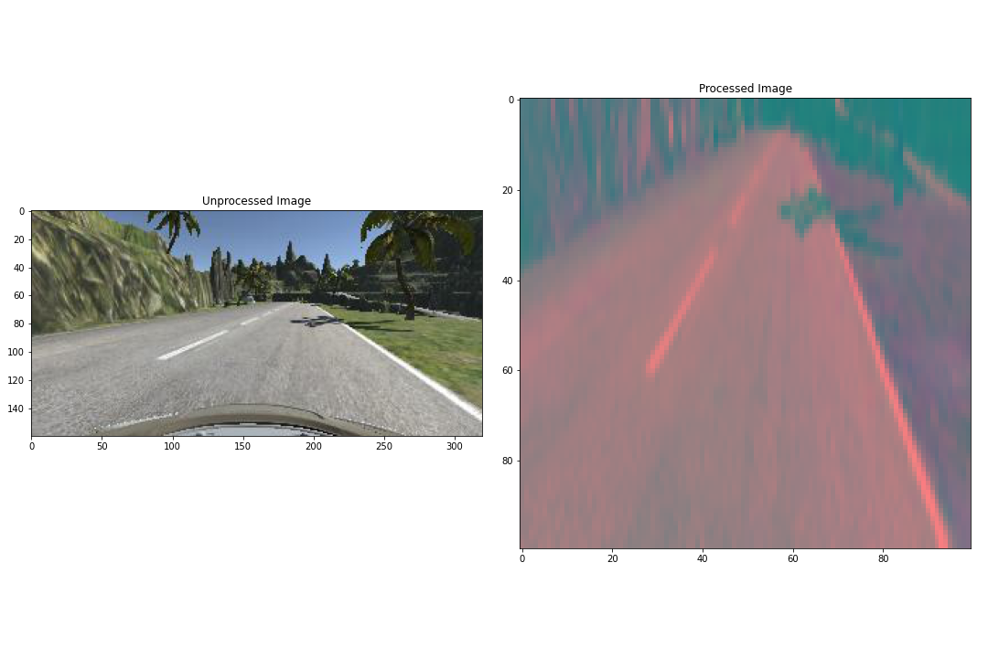
Image processing
To have consistent and readable data for the neural network, images were:
Reshaped
Color Converted
Gaussian Blurred
Augmented

Slide 5
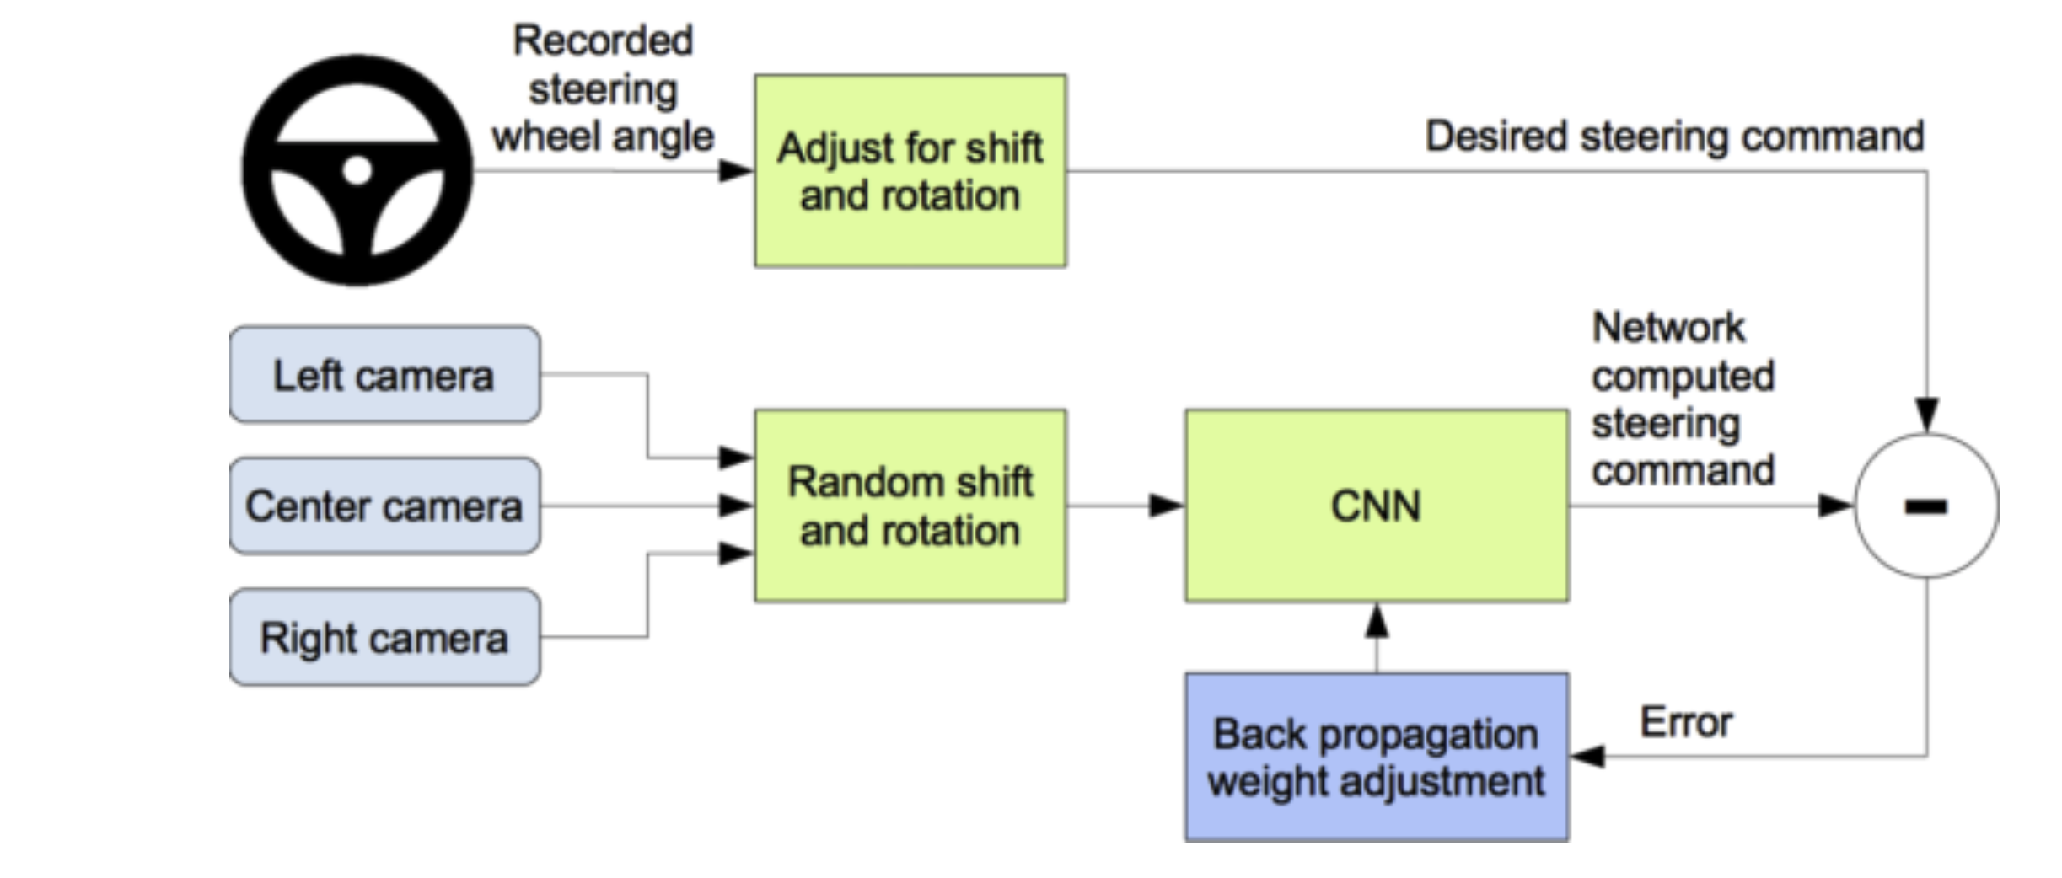
Training the model
Processed images get passed through Convolutional Neural Network
Difference is taken between predicted steering command and desired steering command
Error is back propagated into neural net

Slide 6
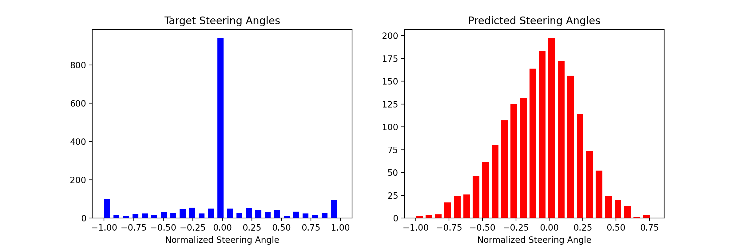
Results
Model predictions show continuous distribution of steering angles
The target dataset is closer to categorical data with 3 frequent steering angles

Slide 7
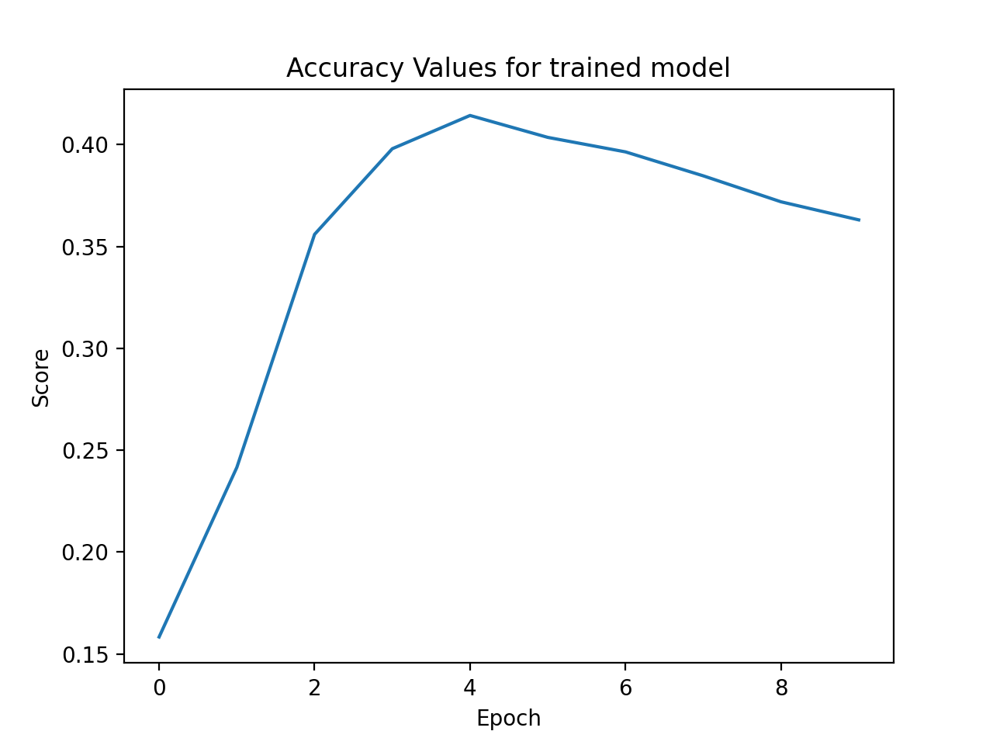
Results
I found that the model performed best at around 5 epochs
This yielded a model accuracy on the training data of approximately 40%
It is unlikely that this model will perform better than the baseline model of the car maintaining constant zero degree steering angle

Slide 8
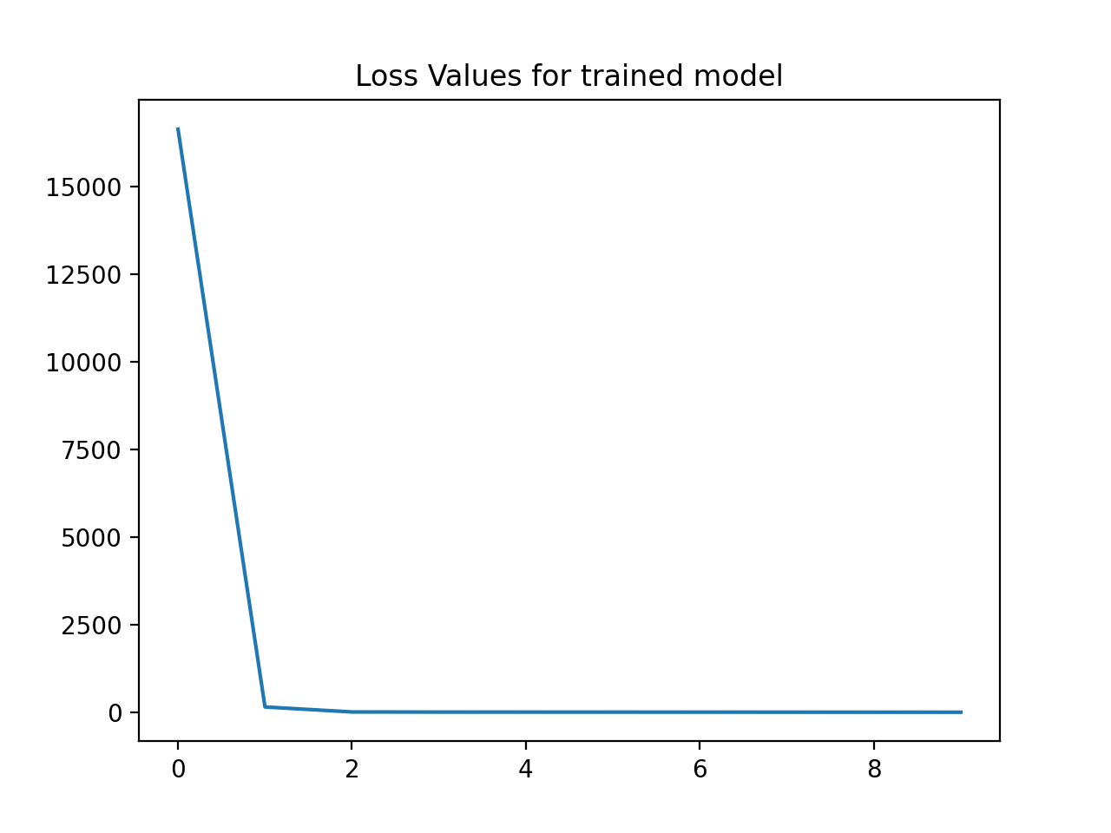
Results
Model loss was calculated using mean squared error
Although model had low accuracy, the loss suggested successful model predictions at around 4 epochs

Slide 9
Insight
The poorly performing model is likely due to a lack of training and validation data
Collecting the data using a keyboard instead of a joystick likely skewed the training data
Although model metrics are a reasonable way to initially assess the model, real world testing is necessary to truly verify the results
Real testing will be done by running the trained model back in the autonomous simulator to verify that the vehicle can successfully drive around an unseen track

